Slide 1
LINEAR PROGRAMMING

Slide 2
A furniture dealer deals in only two items–tables and chairs. He has Rs 50,000 to invest and has storage space of at most 60 pieces. A table costs Rs 2500 and a chair Rs 500. He estimates that from the sale of one table, he can make a profit of Rs 250 and that from the sale of one chair a profit of Rs 75. He wants to know how many tables and chairs he should buy from the available money so as to maximize his total profit, assuming that he can sell all the items which he buys.
Such type of problems which seek to maximise (or, minimise) profit (or, cost) form a general class of problems called optimisation problems. Thus, an optimisation problem may involve finding maximum profit, minimum cost, or minimum use of resources etc.

Slide 3
A special but a very important class of optimization problems is linear programming problem. The above stated optimization problem is an example of linear programming problem. Linear programming problems are of much interest because of their wide applicability in industry, commerce, management science etc.

Slide 4
Linear Programming Problem and its Mathematical Formulation
We begin our discussion with the above example of furniture dealer which will further lead to a mathematical formulation of the problem in two variables. In this example, we observe
(i) The dealer can invest his money in buying tables or chairs or combination thereof. Further he would earn different profits by following different investment strategies.
(ii) There are certain overriding conditions or constraints viz., his investment is limited to a maximum of Rs 50,000 and so is his storage space which is for a maximum of 60 pieces.

Slide 5
Suppose he decides to buy tables only and no chairs,
so he can buy 50000 ÷ 2500, i.e., 20 tables. His profit in this case will be Rs (250 × 20), i.e., Rs 5000.
Suppose he chooses to buy chairs only and no tables. With his capital of Rs 50,000,
he can buy 50000 ÷ 500, i.e. 100 chairs. But he can store only 60 pieces. Therefore, he is forced to buy only 60 chairs which will give him a total profit of Rs (60 × 75), i.e., Rs 4500.
There are many other possibilities, for instance, he may choose to buy 10 tables and 50 chairs, as he can store only 60 pieces. Total profit in this case would be Rs (10 × 250 + 50 × 75), i.e., Rs 6250 and so on.

Slide 6
We, thus, find that the dealer can invest his money in different ways and he would earn different profits by following different investment strategies.
Now the problem is : How should he invest his money in order to get maximum profit? To answer this question, let us try to formulate the problem mathematically.

Slide 7
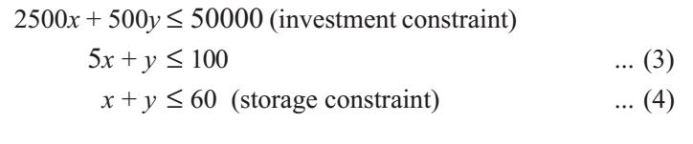
Mathematical formulation of the problem
Let x be the number of tables and y be the number of chairs that the dealer buys. Obviously, x and y must be non-negative, i.e.,
X ≥ 0 ... (1)
(Non-negative constraints)
y ≥ 0 ... (2)
The dealer is constrained by the maximum amount he can invest (Here it is Rs 50,000) and by the maximum number of items he can store (Here it is 60).
Stated mathematically,

Slide 8
The dealer wants to invest in such a way so as to maximize his profit, say, Z which stated as a function of x and y is given by
Z = 250x + 75y (called objective function) ... (5)
Mathematically, the given problems now reduces to:
Maximize Z = 250x + 75y
subject to the constraints:
5x + y ≤ 100
x + y ≤ 60
x ≥ 0, y ≥ 0
So, we have to maximize the linear function Z subject to certain conditions determined by a set of linear inequalities with variables as non-negative.

Slide 9
There are also some other problems where we have to minimize a linear function subject to certain conditions determined by a set of linear inequalities with variables as non-negative. Such problems are called Linear Programming Problems.
Thus, a Linear Programming Problem is one that is concerned with finding the optimal value (maximum or minimum value) of a linear function (called objective function) of several variables (say x and y), subject to the conditions that the variables are non-negative and satisfy a set of linear inequalities (called linear constraints).
The term linear implies that all the mathematical relations used in the problem are linear relations while the term programming refers to the method of determining a particular programme or plan of action.

Slide 10
Objective function Linear function Z = ax + by, where a, b are constants, which has to be maximized or minimized is called a linear objective function.
In the above example, Z = 250x + 75y is a linear objective function.
Variables x and y are called decision variables.
Constraints The linear inequalities or equations or restrictions on the variables of a linear programming problem are called constraints. The conditions x ≥ 0, y ≥ 0 are called non-negative restrictions. In the above example, the set of inequalities (1) to (4) are constraints.
Optimization problem A problem which seeks to maximize or minimize a linear function (say of two variables x and y) subject to certain constraints as determined by a set of linear inequalities is called an optimization problem.
Linear programming problems are special type of optimization problems.

Slide 11
Graphical method of solving linear programming problems
In Class XI, we have learnt how to graph a system of linear inequalities involving two variables x and y and to find its solutions graphically. Let us refer to the problem of investment in tables and chairs discussed. We will now solve this problem graphically. Let us graph the constraints stated as linear inequalities:
5x + y ≤ 100 ... (1)
x + y ≤ 60 ... (2)
x ≥ 0 ... (3)
y ≥ 0 ... (4)

Slide 12
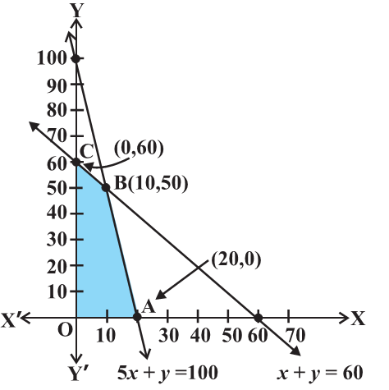
The graph of this system (shaded region) consists of the points common to all half planes determined by the inequalities (1) to (4) (Fig). Each point in this region represents a feasible choice open to the dealer for investing in tables and chairs. The region, therefore, is called the feasible region for the problem. Every point of this region is called a feasible solution to the problem. Thus, we have, Feasible region The common region determined by all the constraints including non-negative constraints x, y ≥ 0 of a linear programming problem is called the feasible region (or solution region) for the problem.
5x + y ≤ 100 ... (1)​
x + y ≤ 60 ... (2)​
x ≥ 0 ... (3)​
y ≥ 0 ... (4)
In Fig, the region OABC (shaded) is the feasible region for the problem.
Fig

Slide 13
The region other than feasible region is called an infeasible region.
Feasible solutions Points within and on the boundary of the feasible region represent feasible solutions of the constraints.
In Fig, every point within and on the boundary of the feasible region OABC represents feasible solution to the problem. For example, the point (10, 50) is a feasible solution of the problem and so are the points (0, 60), (20, 0) etc. Any point outside the feasible region is called an infeasible solution. For example, the point (25, 40) is an infeasible solution of the problem.
5x + y ≤ 100 ... (1)​
x + y ≤ 60 ... (2)​
x ≥ 0 ... (3)​
y ≥ 0 ... (4)
Fig

Slide 14
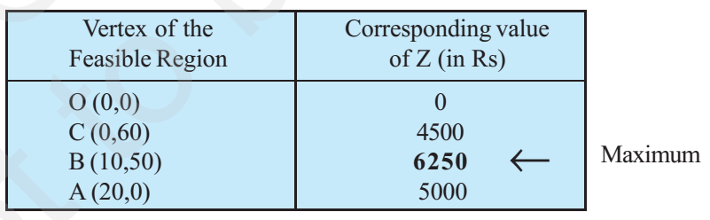
Optimal (feasible) solution: Any point in the feasible region that gives the optimal value (maximum or minimum) of the objective function is called an optimal solution.
Now, we see that every point in the feasible region OABC satisfies all the constraints
as given in (1) to (4), and since there are infinitely many points, it is not evident how we should go about finding a point that gives a maximum value of the objective function
Z = 250x + 75y.
5x + y ≤ 100 ... (1)​
x + y ≤ 60 ... (2)​
x ≥ 0 ... (3)​
y ≥ 0 ... (4)
Fig

Slide 15
We observe that the maximum profit to the dealer results from the investment strategy (10, 50), i.e. buying 10 tables and 50 chairs.
This method of solving linear programming problem is referred as Corner Point Method. The method comprises of the following steps:
1. Find the feasible region of the linear programming problem and determine its corner points (vertices) either by inspection or by solving the two equations of the lines intersecting at that point.
2. Evaluate the objective function Z = ax + by at each corner point. Let M and m, respectively denote the largest and smallest values of these points.
3. (i) When the feasible region is bounded, M and m are the maximum and minimum values of Z.
(ii) In case, the feasible region is unbounded, we have:
4. (a) M is the maximum value of Z, if the open half plane determined by ax + by > M has no point in common with the feasible region. Otherwise, Z has no maximum value.
(b) Similarly, m is the minimum value of Z, if the open half plane determined by ax + by < m has no point in common with the feasible region. Otherwise, Z has no minimum value.

Slide 16
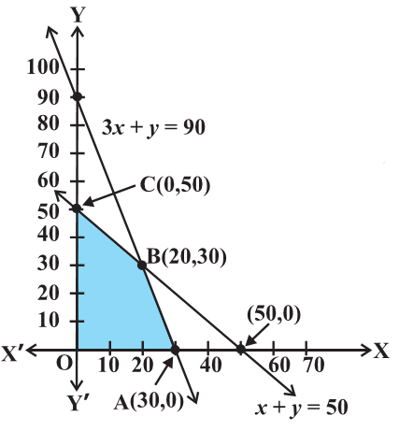

We will now illustrate these steps of Corner Point Method by considering some examples:
Example 1 Solve the following linear programming problem graphically:
Maximise Z = 4x + y ... (1)
subject to the constraints:
x + y ≤ 50 ... (2)
3x + y ≤ 90 ... (3)
x ≥ 0, y ≥ 0 ... (4)
Solution: The shaded region in Fig is the feasible region determined by the system of constraints (2) to (4). We observe that the feasible region OABC is bounded. So, we now use Corner Point Method to determine the maximum value of Z.
The coordinates of the corner points O, A, B and C are (0, 0), (30, 0), (20, 30) and (0, 50) respectively. Now we evaluate Z at each corner point.
Hence, maximum value of Z is 120 at the point (30, 0).
Fig

Slide 17
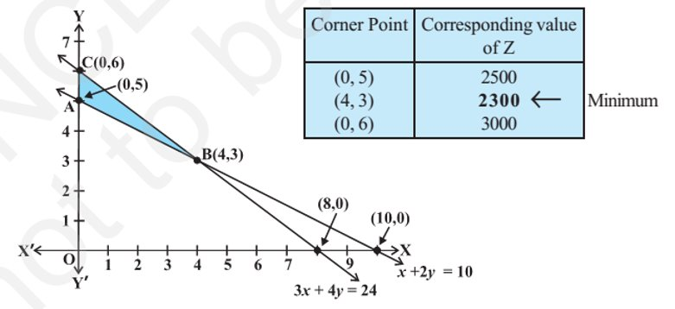
Example 2 Solve the following linear programming problem graphically:
Minimise Z = 200 x + 500 y ... (1)
subject to the constraints:
x + 2y ≥ 10 ... (2)
3x + 4y ≤ 24 ... (3)
x ≥ 0, y ≥ 0 ... (4)
Solution The shaded region in Fig is the feasible region ABC determined by the system of constraints (2) to (4), which is bounded.
Fig
The coordinates of corner points A, B and C are (0,5), (4,3) and (0,6) respectively. Now we evaluate Z = 200x + 500y at these points.​
Hence, minimum value of Z is 2300 attained at the point (4, 3)​

Slide 18
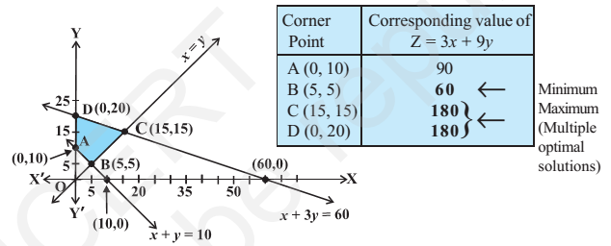
Example 3 Solve the following problem graphically:
Minimise and Maximise Z = 3x + 9y ... (1)
subject to the constraints:
x + 3y ≤ 60 ... (2)
x + y ≥ 10 ... (3)
x ≤ y ... (4)
x ≥ 0, y ≥ 0 ... (5)
Solution First of all, let us graph the feasible region of the system of linear inequalities (2) to (5). The feasible region ABCD is shown in the Fig. Note that the region is bounded.
The coordinates of the corner points A, B, C and D are (0, 10), (5, 5), (15,15) and (0, 20) respectively.
We now find the minimum and maximum value of Z. From the table, we find that the minimum value of Z is 60 at the point B (5, 5) of the feasible region.
The maximum value of Z on the feasible region occurs at the two corner points C (15, 15) and D (0, 20) and it is 180 in each case.

Slide 19
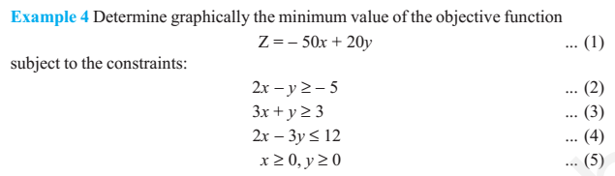
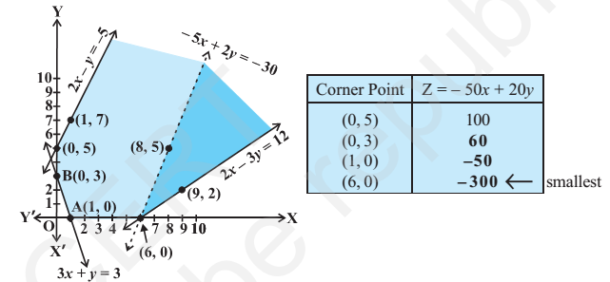
Solution First of all, let us graph the feasible region of the system of inequalities (2) to (5). The feasible region (shaded) is shown in the Fig. Observe that the feasible region is unbounded. We now evaluate Z at the corner points.
Fig

Slide 20
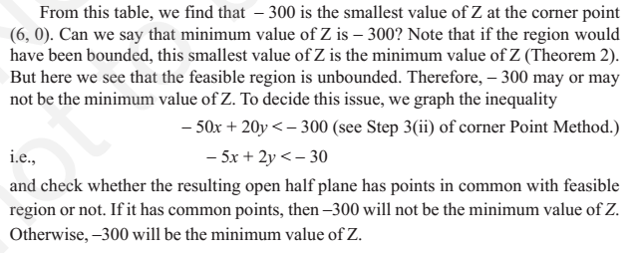

Slide 21
Different Types of Linear Programming Problem
A few important linear programming problems are listed below:
1. Manufacturing problems In these problems, we determine the number of units of different products which should be produced and sold by a firm when each product requires a fixed manpower, machine hours, labour hour per unit of product, warehouse space per unit of the output etc., in order to make maximum profit.
2. Diet problems In these problems, we determine the amount of different kinds of constituents/nutrients which should be included in a diet so as to minimise the cost of the desired diet such that it contains a certain minimum amount of each
constituent/nutrients.
3. Transportation problems In these problems, we determine a transportation schedule in order to find the cheapest way of transporting a product from plants/factories situated at different locations to different markets.

Slide 22
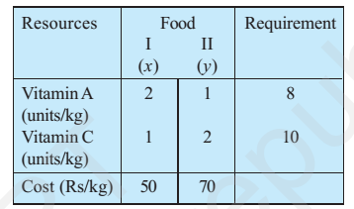
(Diet problem): A dietician wishes to mix two types of foods in such a way that vitamin contents of the mixture contain atleast 8 units of vitamin A and 10 units of vitamin C. Food ‘I’ contains 2 units/kg of vitamin A and 1 unit/kg of vitamin C. Food ‘II’ contains 1 unit/kg of vitamin A and 2 units/kg of vitamin C. It costs Rs 50 per kg to purchase Food ‘I’ and Rs 70 per kg to purchase Food ‘II’. Formulate this problem as a linear programming problem to minimize the cost of such a mixture.
Solution Let the mixture contain x kg of Food ‘I’ and y kg of Food ‘II’. Clearly, x ≥ 0, y ≥ 0.​ We make the following table from the given data:
Since the mixture must contain at least 8 units of vitamin A and 10 units of vitamin C, we have the constraints:
2x + y ≥ 8
x + 2y ≥ 10
Total cost Z of purchasing x kg of food ‘I’ and y kg of Food ‘II’ is Z = 50x + 70y

Slide 23
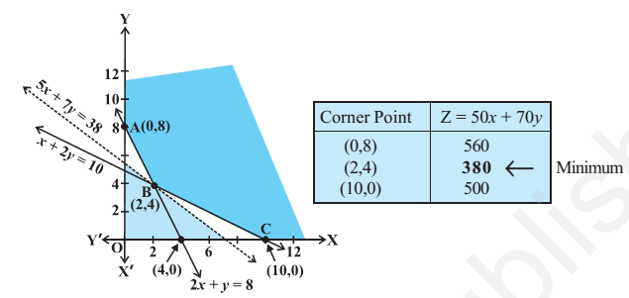
Hence, the mathematical formulation of the problem is:
Minimize Z = 50x + 70y ... (1)
subject to the constraints:
2x + y ≥ 8 ... (2)
x + 2y ≥ 10 ... (3)
x, y ≥ 0 ... (4)
Let us graph the inequalities (2) to (4). The feasible region determined by the system is shown in the Fig. Here again, observe that the feasible region is unbounded.

Slide 24
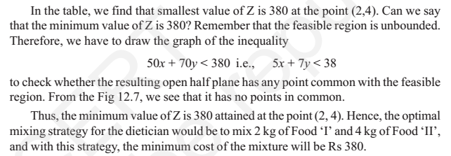

Slide 25
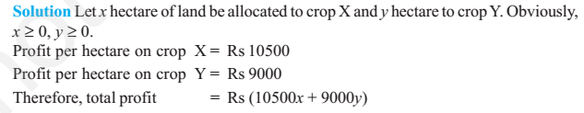
(Allocation problem) A cooperative society of farmers has 50 hectare of land to grow two crops X and Y. The profit from crops X and Y per hectare are estimated as Rs 10,500 and Rs 9,000 respectively. To control weeds, a liquid herbicide has to be used for crops X and Y at rates of 20 litres and 10 litres per hectare. Further, no more than 800 litres of herbicide should be used in order to protect fish and wild life using a pond which collects drainage from this land. How much land should be allocated to each crop so as to maximize the total profit of the society?

Slide 26
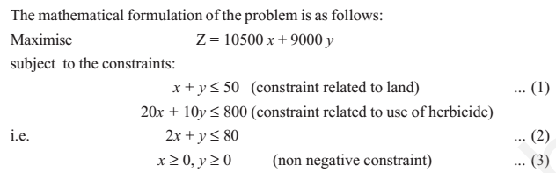
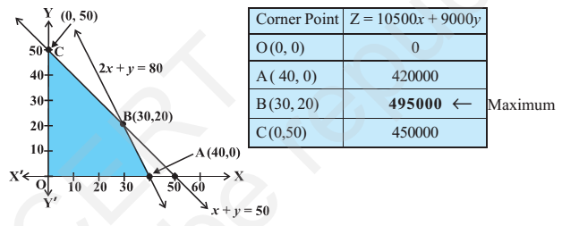
Let us draw the graph of the system of inequalities (1) to (3). The feasible region OABC is shown (shaded) in the Fig. Observe that the feasible region is bounded.
The coordinates of the corner points O, A, B and C are (0, 0), (40, 0), (30, 20) and (0, 50) respectively. Let us evaluate the objective function Z = 10500 x + 9000y at these vertices to find which one gives the maximum profit.
Hence, the society will get the maximum profit of Rs 4,95,000 by allocating 30 hectares for crop X and 20 hectares for crop Y.

Slide 27
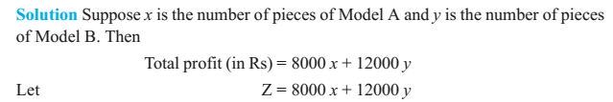
(Manufacturing problem) A manufacturing company makes two models A and B of a product. Each piece of Model A requires 9 labour hours for fabricating and 1 labour hour for finishing. Each piece of Model B requires 12 labour hours for fabricating and 3 labour hours for finishing. For fabricating and finishing, the maximum labour hours available are 180 and 30 respectively. The company makes a profit of Rs 8000 on each piece of model A and Rs 12000 on each piece of Model B. How many pieces of Model A and Model B should be manufactured per week to realise a maximum profit? What is the maximum profit per week?

Slide 28
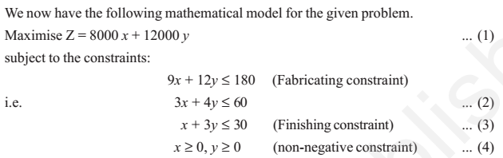
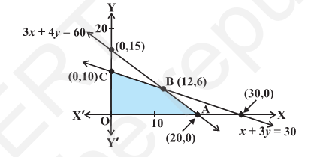
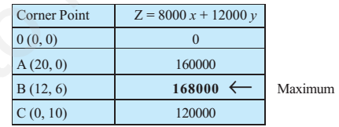
The feasible region (shaded) OABC determined by the linear inequalities (2) to (4)
is shown in the Fig. Note that the feasible region is bounded.
We find that maximum value of Z is 1,68,000 at B (12, 6). Hence, the company should produce 12 pieces of Model A and 6 pieces of Model B to realise maximum profit and maximum profit then will be Rs 1,68,000.
Fig

Slide 29
Formulating a problem – Let’s manufacture some chocolates
Example: Consider a chocolate manufacturing company that produces only two types of chocolate – A and B. Both the chocolates require Milk and Choco only. To manufacture each unit of A and B, the following quantities are required:
Each unit of A requires 1 unit of Milk and 3 units of Choco
Each unit of B requires 1 unit of Milk and 2 units of Choco
The company kitchen has a total of 5 units of Milk and 12 units of Choco. On each sale, the company makes a profit of
Rs 6 per unit A sold
Rs 5 per unit B sold.
Now, the company wishes to maximize its profit. How many units of A and B should it produce respectively?

Slide 30
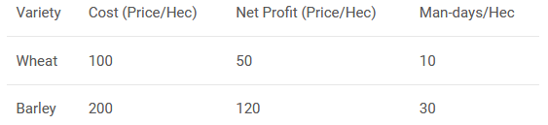
Example: A farmer has recently acquired a 110 hectares piece of land. He has decided to grow Wheat and barley on that land. Due to the quality of the sun and the region’s excellent climate, the entire production of Wheat and Barley can be sold. He wants to know how to plant each variety in the 110 hectares, given the costs, net profits and labor requirements according to the data shown below:
The farmer has a budget of US$10,000 and availability of 1,200 man-days during the planning horizon. Find the optimal solution and the optimal value.

Slide 31
Example: A toy manufacturing organization manufactures two types of toys A and B. Both the toys are sold at Rs.25 and Rs.20 respectively. There are 2000 resource units available every day from which the toy A requires 20 units while toy B requires 12 units. Both of these toys require a production time of 5 minutes. Total working hours are 9 hours a day. What should be the manufacturing quantity for each of the pipes to maximize the profits?

Slide 32
References:
http://ncert.nic.in/ncerts/l/lemh206.pdf
https://www.analyticsvidhya.com/blog/2017/02/lintroductory-guide-on-linear-programming-explained-in-simple-english/
Quiz
http://tiny.cc/lpgm1

